Slide 1


Slide 2
HOMEWORK
Create your notable horse's lifespan profile and send it to
equestriancoach@outlook.com.
Download the template slide: www.equestrianinsider.com
Best stories may be featured in the upcoming videos!

Slide 3
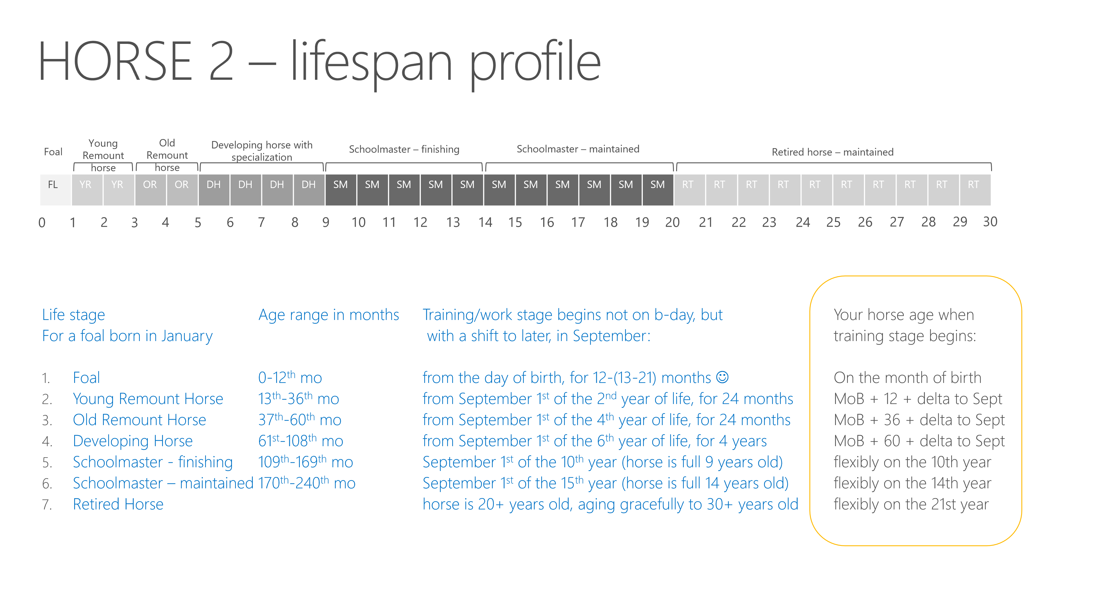

Slide 4

HORSE NAME 1

Slide 5
HORSE NAME 1 – lifespan profile
Foal
Young Remount horse
Old Remount horse
Developing horse with specialization
Schoolmaster – finishing
Schoolmaster – maintained
Retired horse – maintained
FL | YR | YR | OR | OR | DH | DH | DH | DH | SM | SM | SM | SM | SM | SM | SM | SM | SM | SM | SM | RT | RT | RT | RT | RT | RT | RT | RT | RT | RT
0
1
2
3
4
5
6
7
8
9
10
11
12
13
14
15
16
17
18
19
20
21
22
23
24
25
26
27
28
29
30
  Please color code the timeline above for your horse as you saw it in video EXAMPLES. Mark below its key milestones:
  Date of birth: MM/DD/YYYY Retired on: MM/YYYY Lived through: MM/DD/YYYY Breed: ___________________
  Time of breaking started: ________________________________________
  Time of the first competition: _____________________________________________________
  Time when a horse was specialized, which discipline: ___________________________________________ Was there a change in specialization? _________
  Dates and nature of inhibitors, issues, injuries: ____________________________________
  How many owners a horse has had: ____________________________________________________
  How many bereuters and riders a horse had, dates of switching: _________________________________________________

Slide 6
HORSE NAME 2

Slide 7
HORSE NAME 2 – lifespan profile
Foal
Young Remount horse
Old Remount horse
Developing horse with specialization
Schoolmaster – finishing
Schoolmaster – maintained
Retired horse – maintained
FL | YR | YR | OR | OR | DH | DH | DH | DH | SM | SM | SM | SM | SM | SM | SM | SM | SM | SM | SM | RT | RT | RT | RT | RT | RT | RT | RT | RT | RT
0
1
2
3
4
5
6
7
8
9
10
11
12
13
14
15
16
17
18
19
20
21
22
23
24
25
26
27
28
29
30
  Please color code the timeline above for your horse as you saw it in video EXAMPLES. Mark below its key milestones:
  Date of birth: MM/DD/YYYY Retired on: MM/YYYY Lived through: MM/DD/YYYY Breed: ___________________
  Time of breaking started: ________________________________________
  Time of the first competition: _____________________________________________________
  Time when a horse was specialized, which discipline: ___________________________________________ Was there a change in specialization? _________
  Dates and nature of inhibitors, issues, injuries: ____________________________________
  How many owners a horse has had: ____________________________________________________
  How many bereuters and riders a horse had, dates of switching: _________________________________________________

Slide 8
HORSE NAME 3

Slide 9
HORSE NAME 2 – lifespan profile
Foal
Young Remount horse
Old Remount horse
Developing horse with specialization
Schoolmaster – finishing
Schoolmaster – maintained
Retired horse – maintained
FL | YR | YR | OR | OR | DH | DH | DH | DH | SM | SM | SM | SM | SM | SM | SM | SM | SM | SM | SM | RT | RT | RT | RT | RT | RT | RT | RT | RT | RT
0
1
2
3
4
5
6
7
8
9
10
11
12
13
14
15
16
17
18
19
20
21
22
23
24
25
26
27
28
29
30
  Please color code the timeline above for your horse as you saw it in video EXAMPLES. Mark below its key milestones:
  Date of birth: MM/DD/YYYY Retired on: MM/YYYY Lived through: MM/DD/YYYY Breed: ___________________
  Time of breaking started: ________________________________________
  Time of the first competition: _____________________________________________________
  Time when a horse was specialized, which discipline: ___________________________________________ Was there a change in specialization? _________
  Dates and nature of inhibitors, issues, injuries: ____________________________________
  How many owners a horse has had: ____________________________________________________
  How many bereuters and riders a horse had, dates of switching: _________________________________________________

Slide 10
HOMEWORK
Create your notable horse's lifespan profile and send it to
equestriancoach@outlook.com.
Download the template slide: www.equestrianinsider.com
Best stories may be featured in the upcoming videos!

Slide 11
Thank you!

